Slide 1
DEPARTMENT OF ADMINISTRATION preserving the past, serving people today, planning for tomorrow
2022-2023 AGENCY Presentation
State Public works Board
EITS CIP Requests
August 27, 2020
LAURA E. FREED, Director
Dave Haws, EITS Administrator

Slide 2
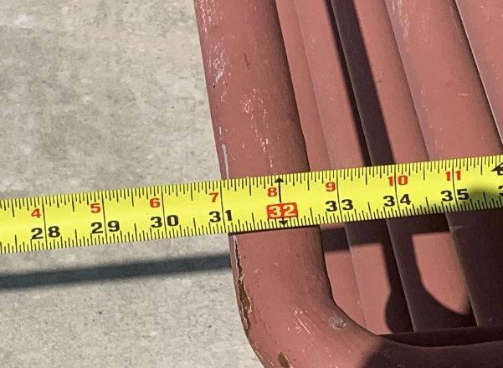
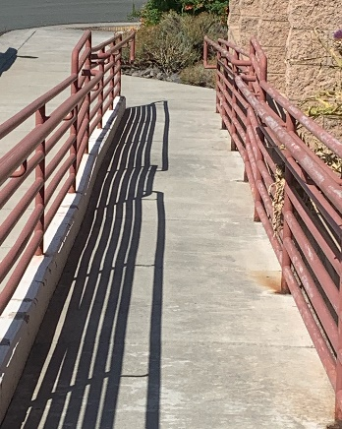
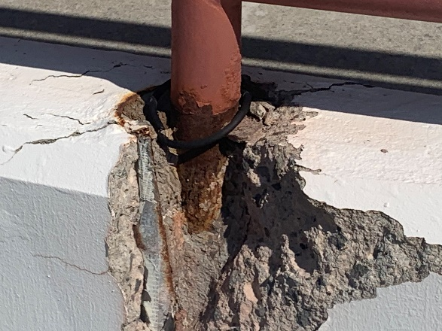
CIP #21268
Replace Data Center Facility Stairs EITS
Project Need: The stairs at the facility have become a safety ISSUE and need to be replaced. The concrete is crumbling and is Now a trip and fall Hazard. Handrails are no longer secure and the ramp, which is a fire exit, is not ADA compliant.
Project Description: replace the stairs and ramp at the facility to meet Ada compliance and safety needs. replace the assess gate and Ground dock lift.

Slide 3
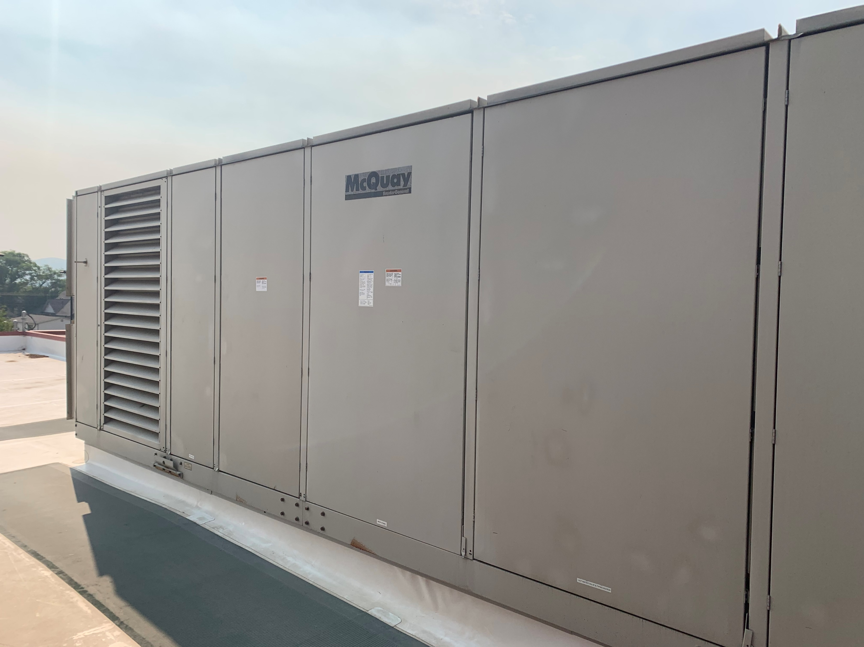
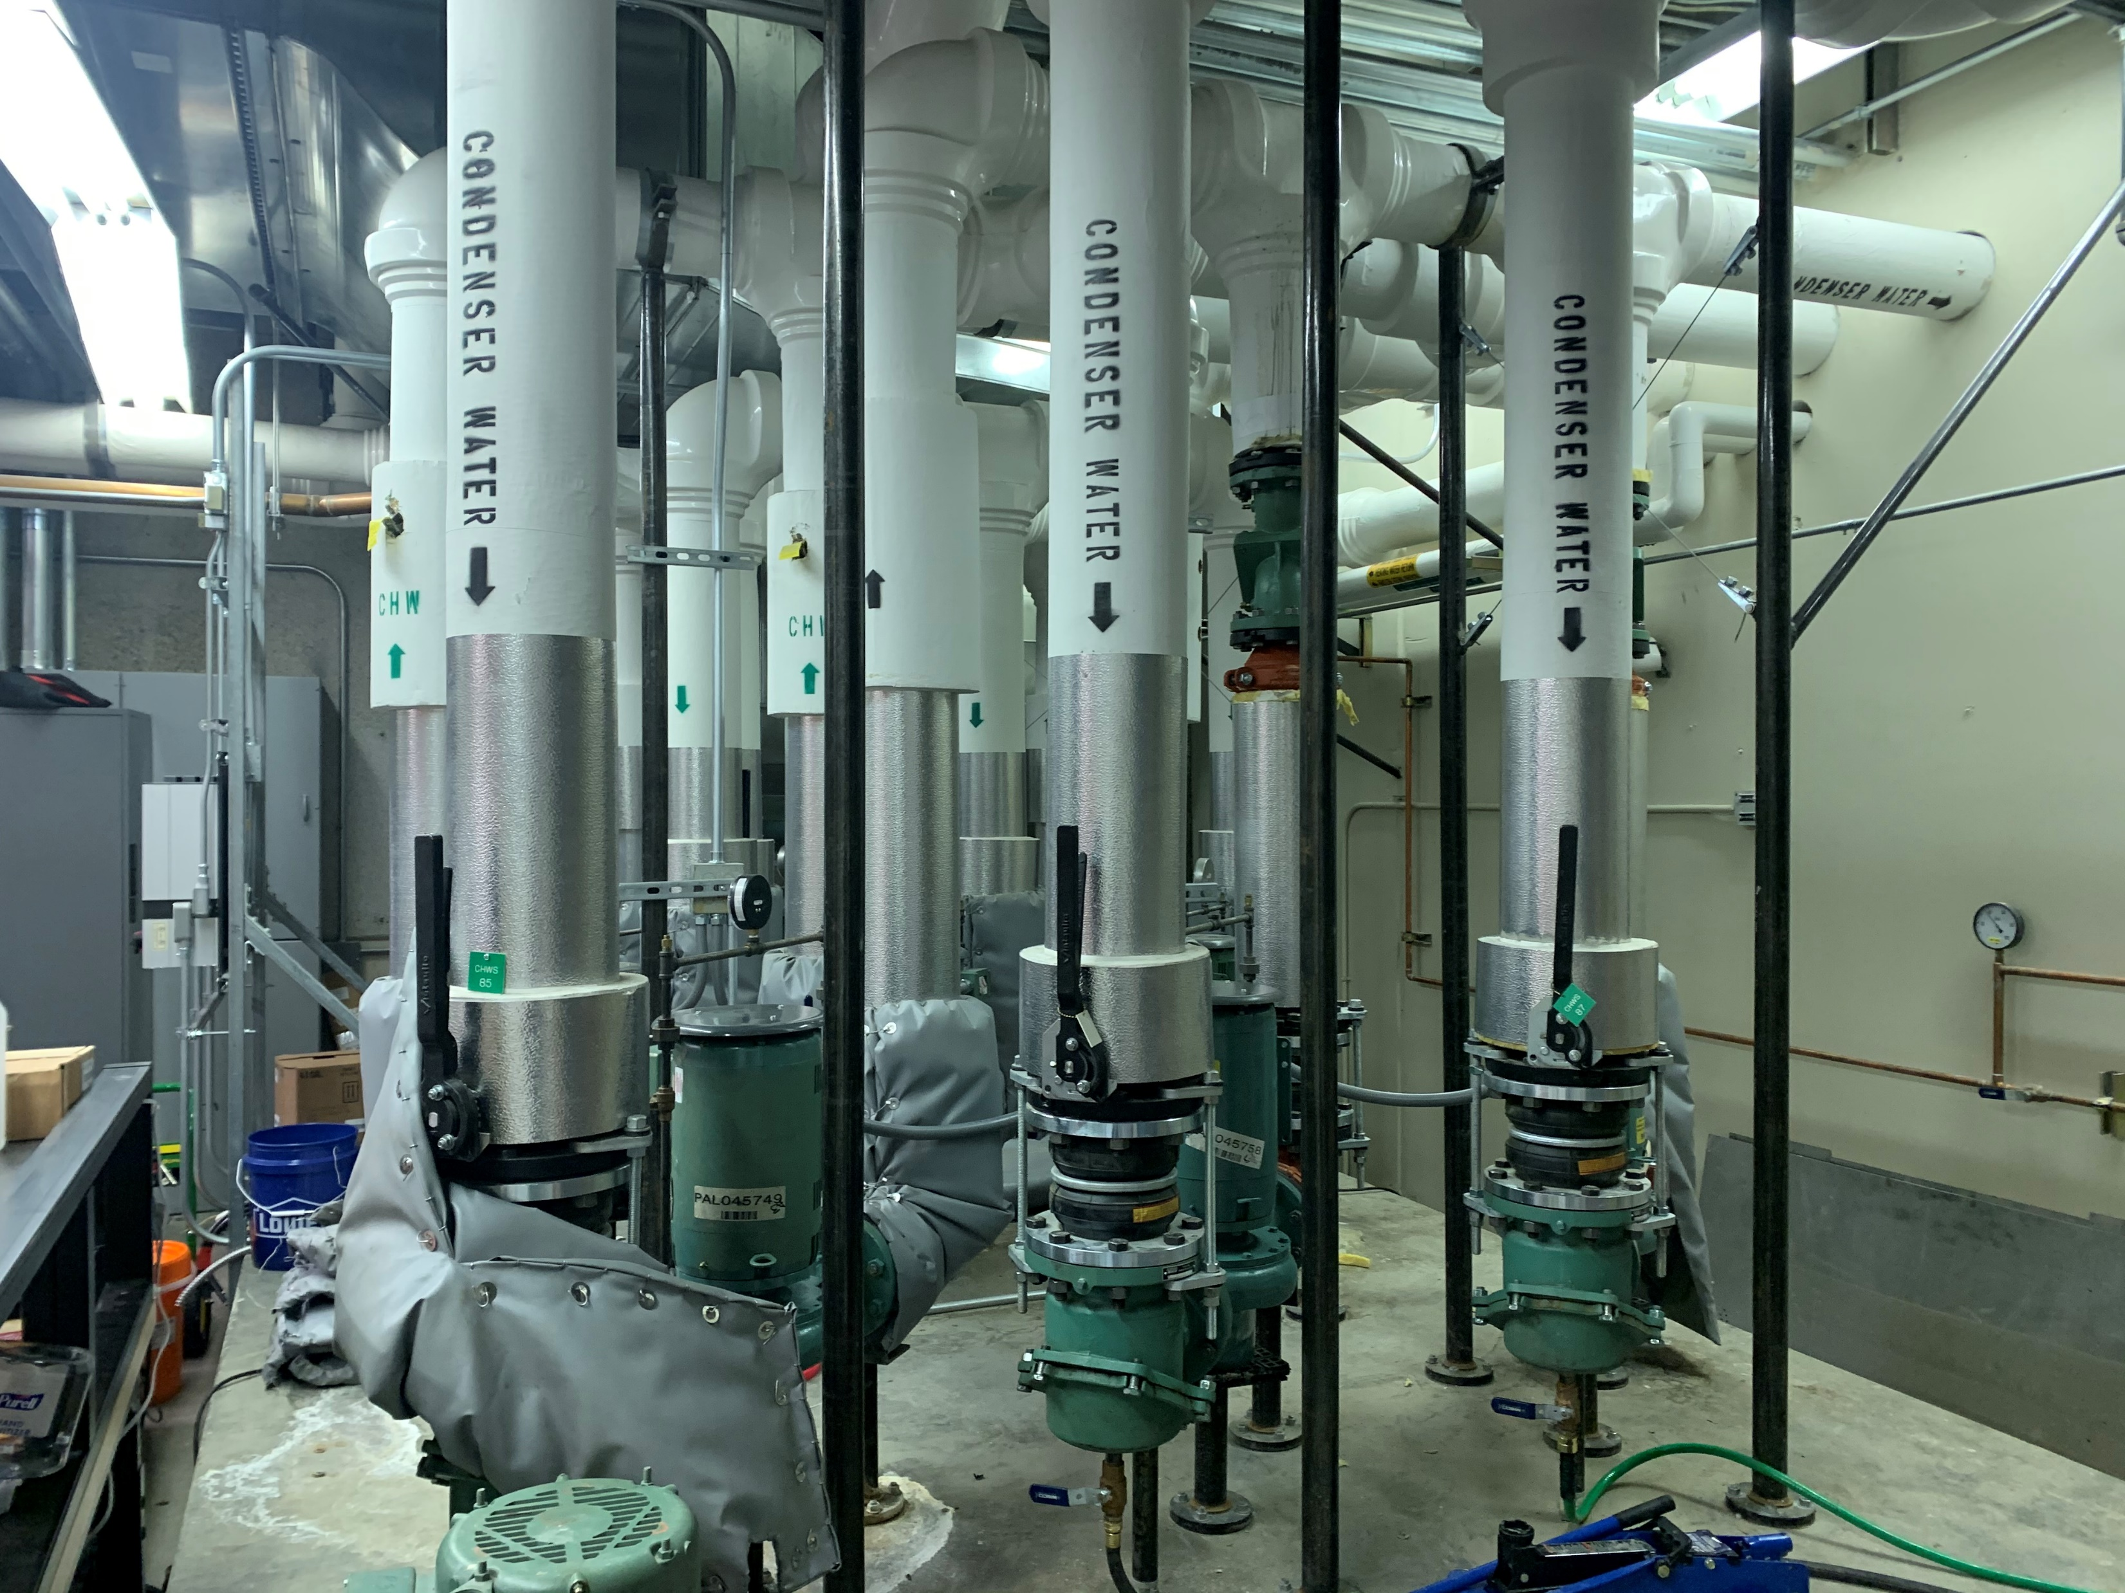
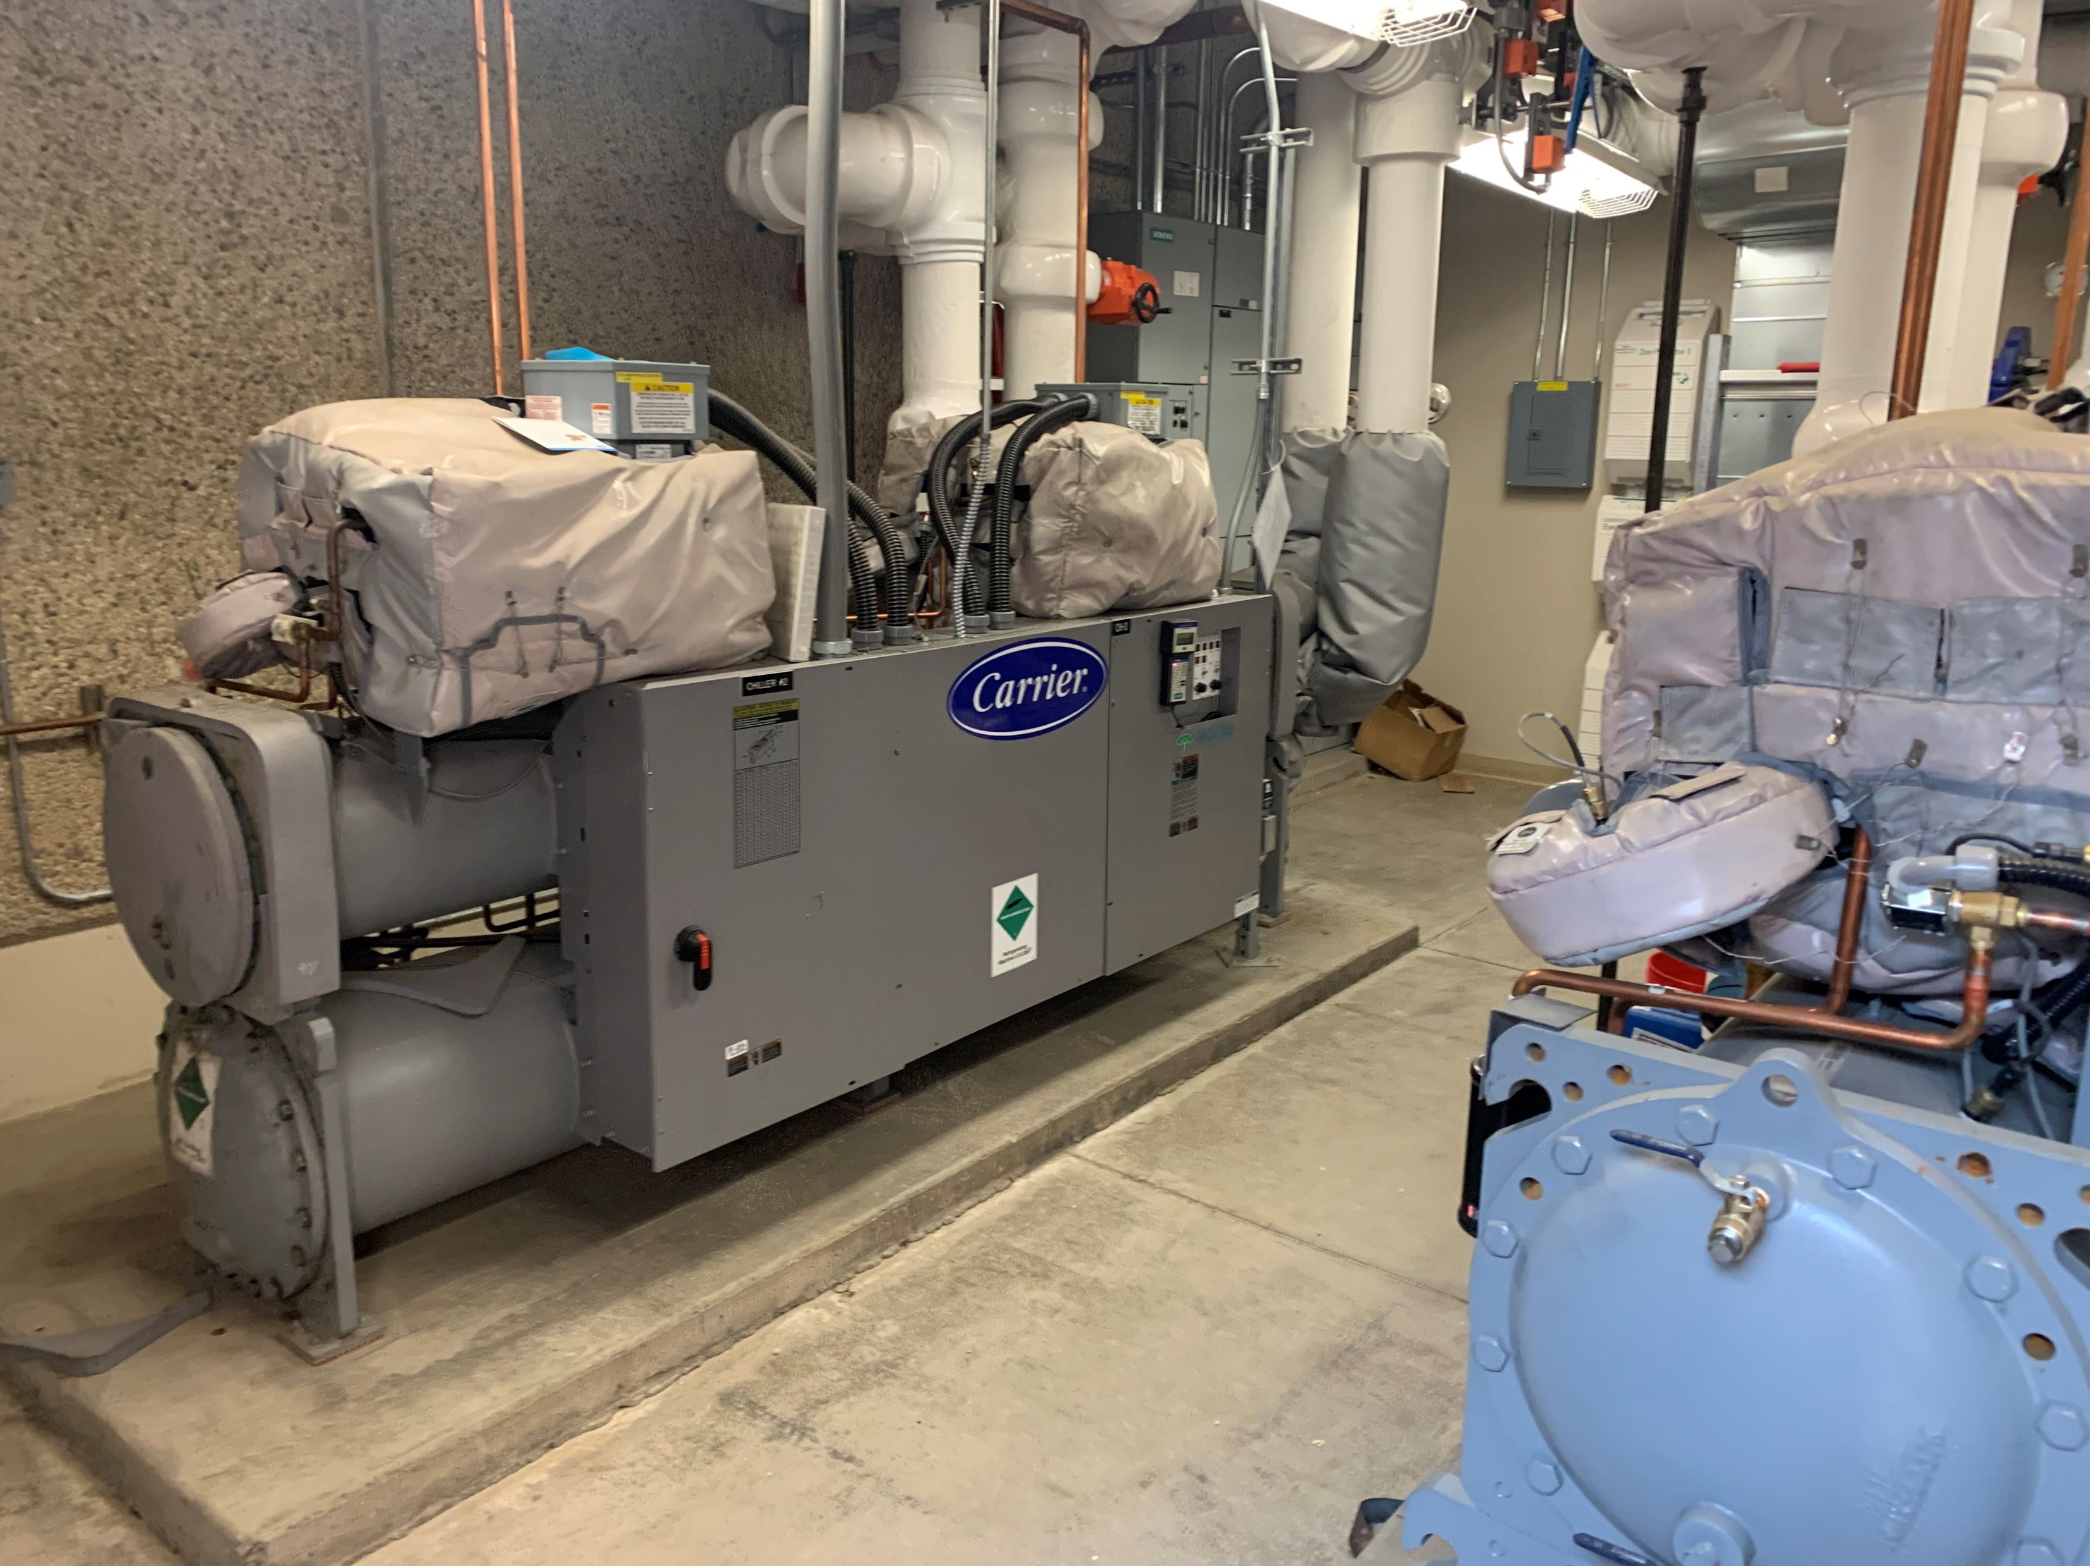
CIP #21269
Computing Room Cooling System Upgrade EITS
Project Need: The existing Computing facility air conditioning equipment is more than 15 years old and is reaching end of useful service.
Project Description: replace and augment the existing air conditioning equipment that serves the main server room, computer workshop, and communications equipment room at the State Computer Facility in Carson City.

Slide 4
Q&A
?

